Slide 1

Analyzing Banking agencies in Casablanca
Presenter Name

Slide 2




Introduction
This study is about banking in Casablanca. We aim to identify key factors for bank implementation and create readable vizualisation.

Slide 3



Data Gathering : Getting data from different sources and merging it
From google places API we get:
location of all banks in Casablanca
Location of all restaurants in Casablanca and their specificities
From Mubawab we get all listings for sales in Casablanca and their specificities
From the HCP we get all socio-demographic data about Casablanca’s districts
Data

Slide 4
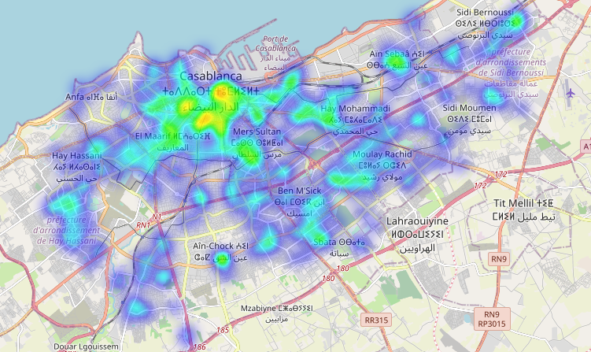
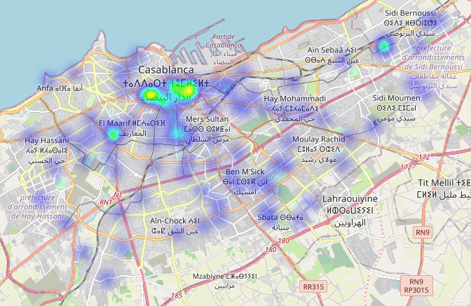
Heatmap of bank agencies
All banks
The bank agencies we identified are distributed in Casablanca according the heatmaps :
The coordinates of those banks are from Google API
Attijari

Slide 5
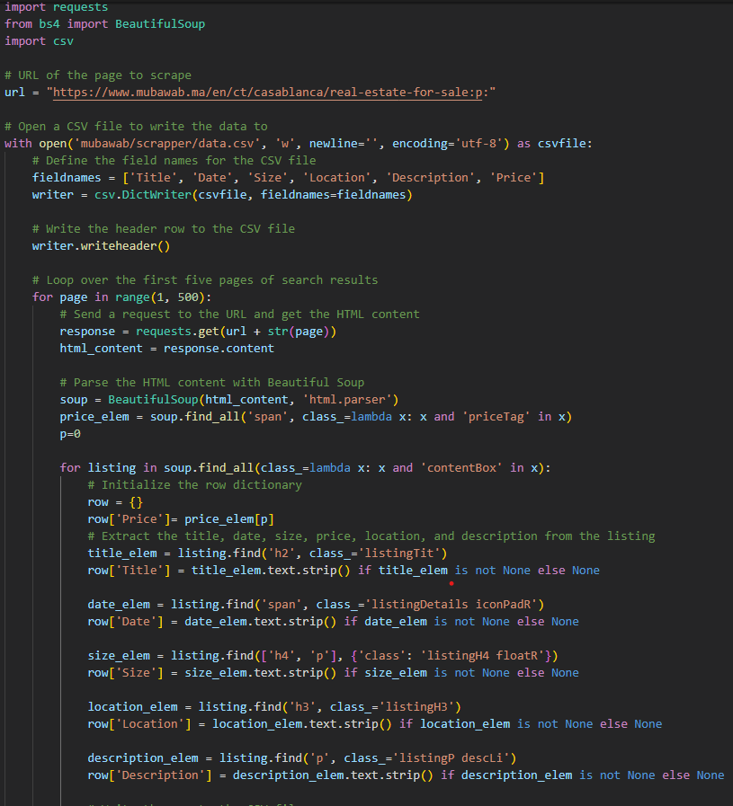

Scrapping Mubawab
We first scrapped muubawab.ma to gather square meter price and group by zone. Data is then cleaned, and we obtain the following columns :
Title
Date
Size
Location
Description
Num. bedrooms
Price
Square meter price

Slide 6
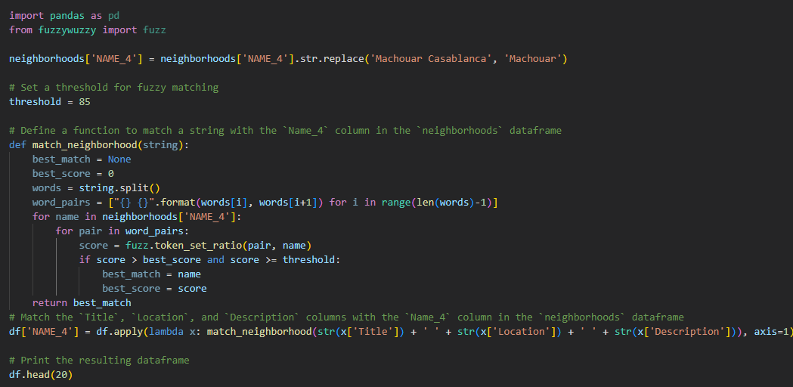
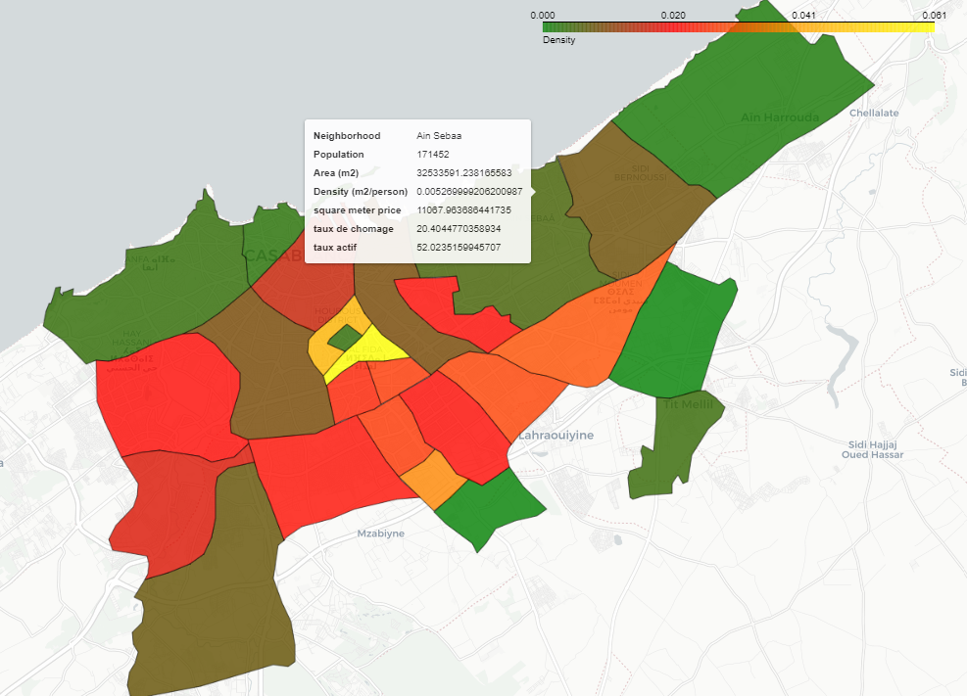
Incorporating HCI data and computing SQMP for districts
Thanks to the HCI, we have demographics of 2014’s decennial national census. This data is detailed on 20 districts in Casablanca.
Using FuzzyMatching, we associated each listing of mubawab to a district, to further compute square meter price. Districts are represented by polygons, and all information is available as GeoJson and GeoDataFrame.

Slide 7
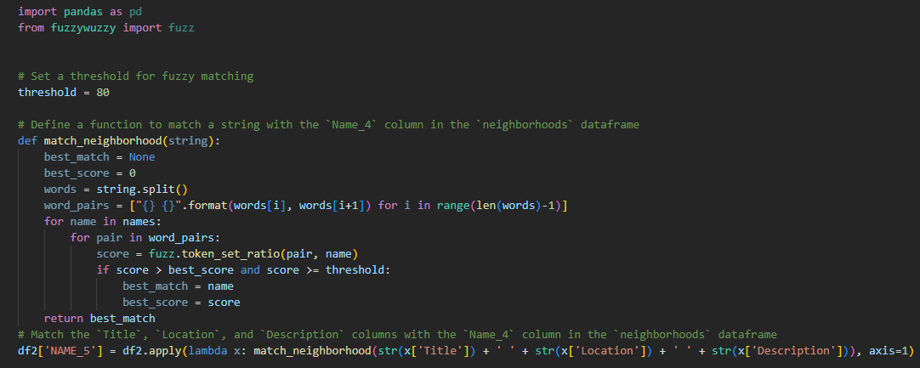
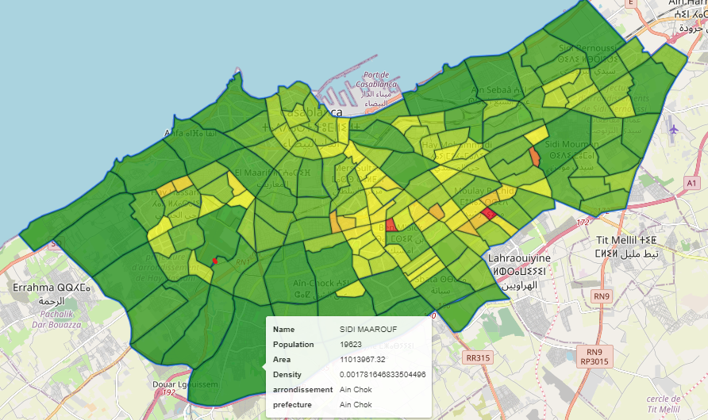
Computing SQMP for Microzones
A more granular way to see Casablanca is through neighborhoods (Microzones). The map is separated in 162 microzones.
Using FuzzyMatching, we associated each listing of mubawab to a microzone, to get a square meter price that is more precise. Missing values are computed using weighting averages based on distances between polygons

Slide 8
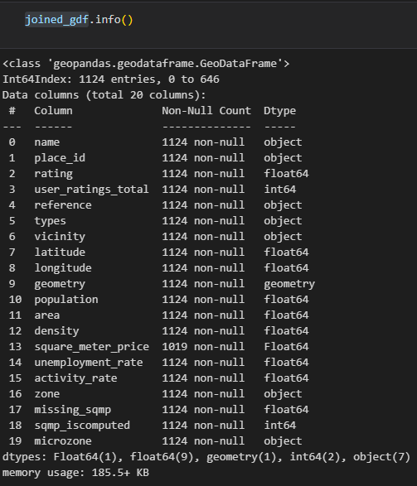
Merging Data gathered with banks dataset
After getting all socio-demographic, geographic and real estate Data, we merged it with our banks dataset, of all bank agencies in Casablanca.
Square_meter_price is the price computed on districts, while missing_sqmp is for microzones. Sqmp_iscomputed is a Boolean informing whether or not missing_sqmp has been computed due to missing value after fuzzy matching.

Slide 9
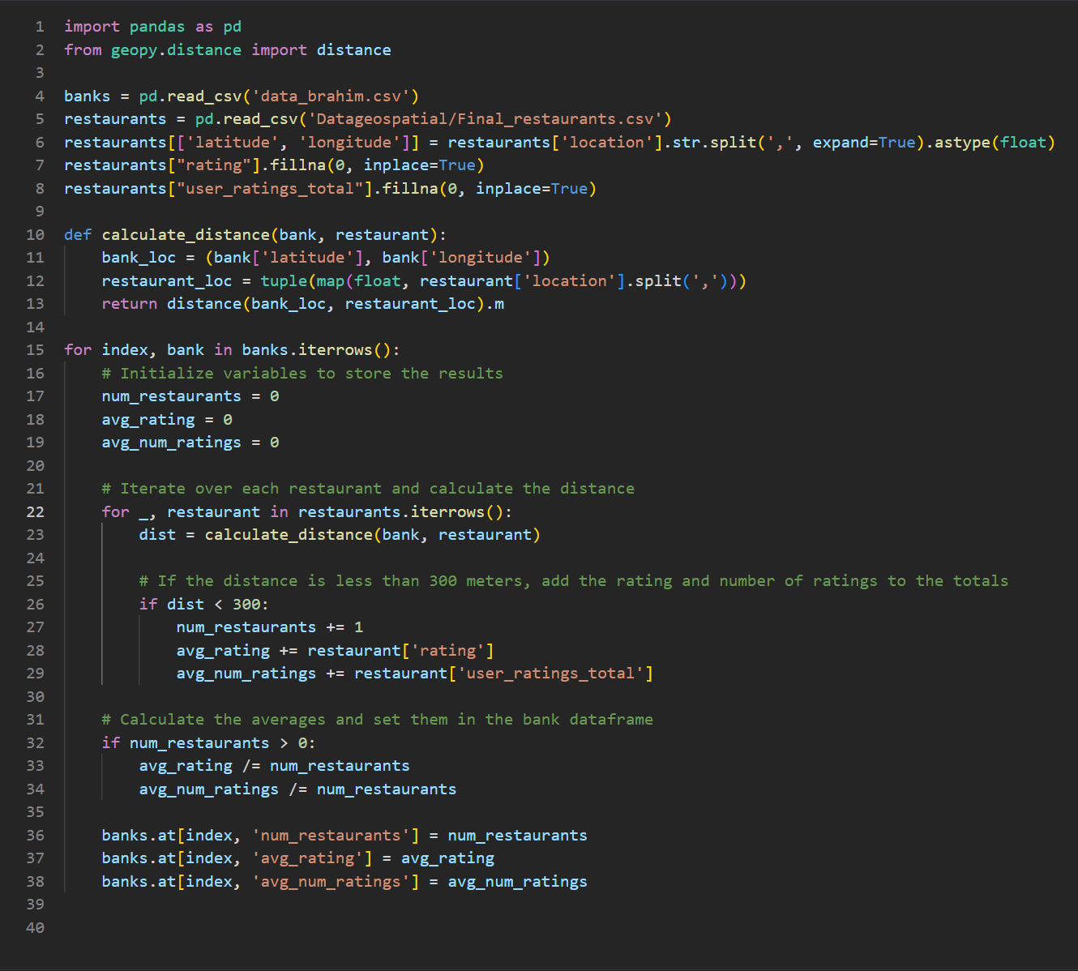
Merging Dataset with restaurants
After getting our socio-demographic and real estate data matched with our banks, we measured, for each bank, the number of restaurants around it, we computed the average rating and the average number of ratings for those restaurants to try to capture traffic signs.

Slide 10

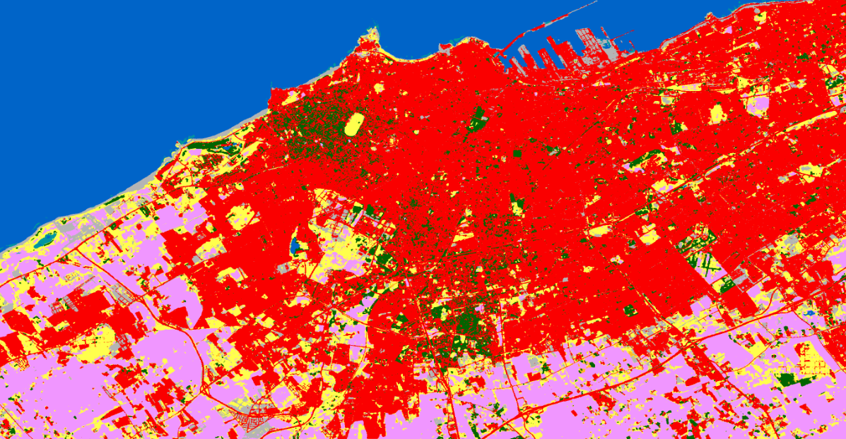
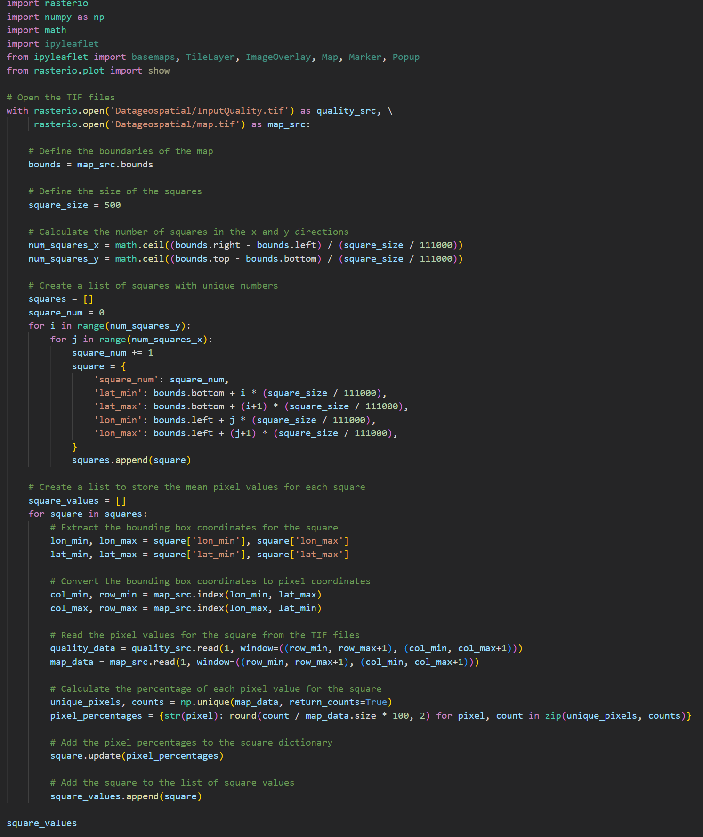
Adding Data from ESA
Thanks to the work done by ESA and its worldcover view, we hashed Casablanca in squares of 500m and calculated the number of pixels of each color, eventually giving us the percentage of buildings, grass, trees … This data has then been merged with our banks dataset to evaluate which features affect the most the location of banks
ESA worldcover view
code

Slide 11
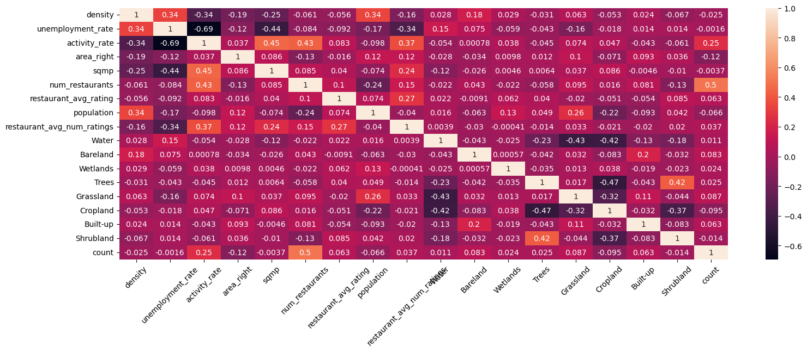
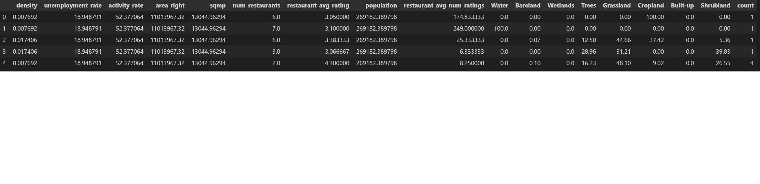
Linear feature importance
For each of our 500m squares we counted the number of banks and created the feature “count” as our target, to predict the number of banks in the zone according to square meter price, demographics, satellite views and restaurants. The confusion matrix shows that the most important features are the number of restaurants under 500m and the activity rate. Square meter price seems to not be linearly correlated but there is certainly a non-linear correlation, especially if density is added to the equation.

Slide 12
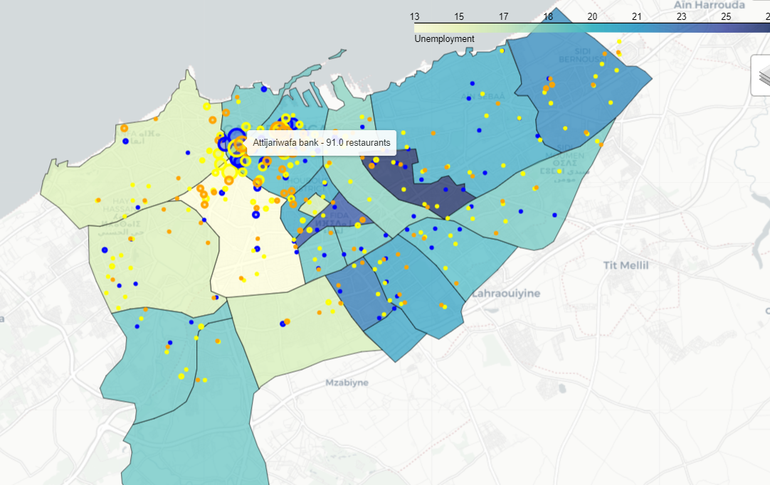
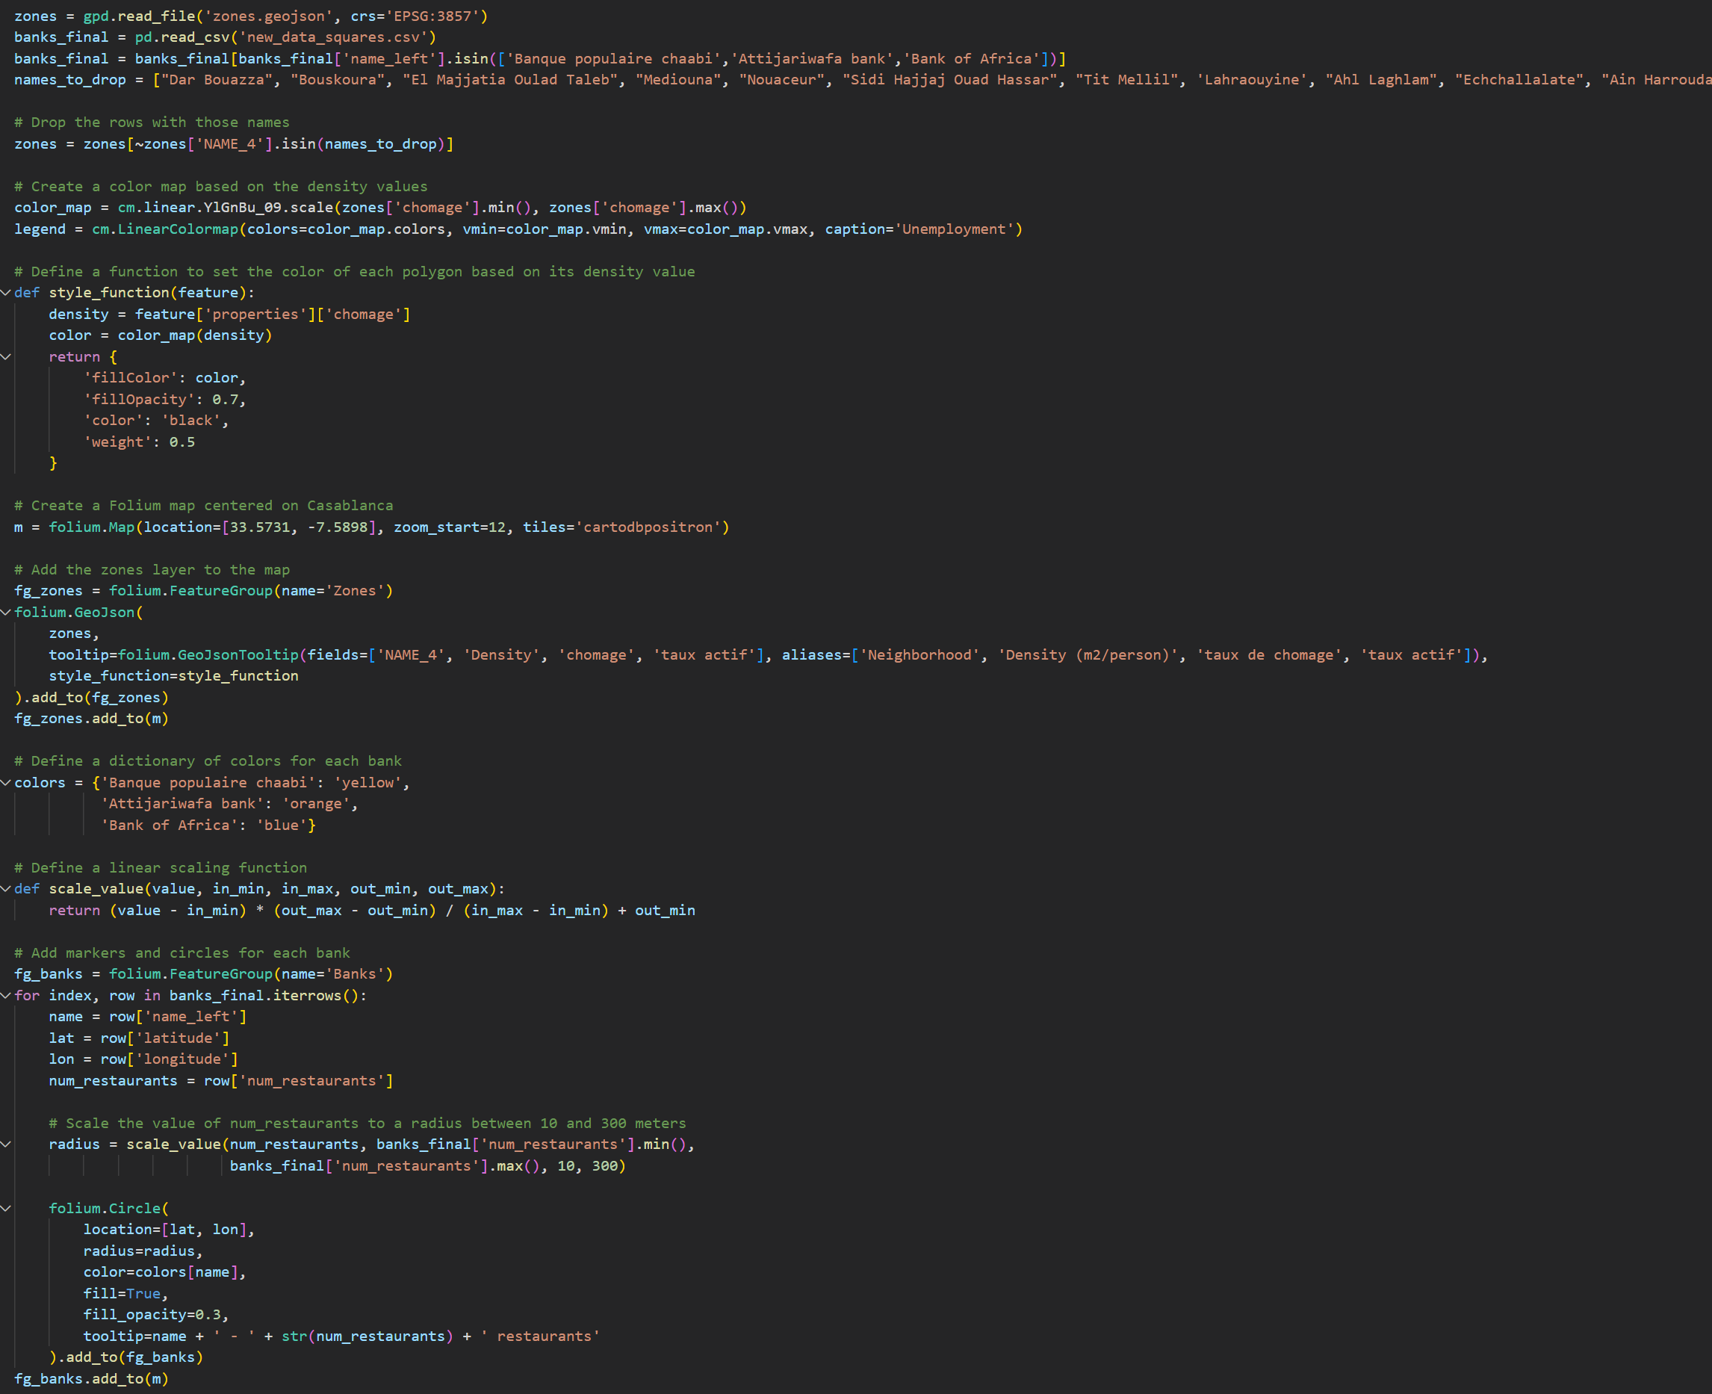
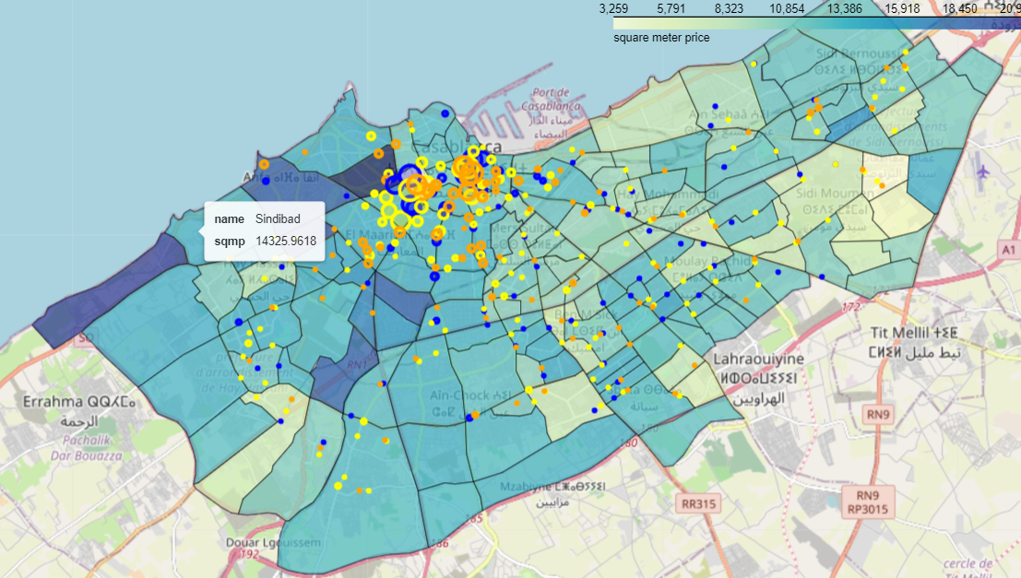
Mapping
Unemployment rate
Code
Square meter price

Slide 13


Thank You
Presenter name
Email address
Website address

